Slide 1

Consumer Finance Complaint Analysis
Guided by: Prof. Qi Yu Akshay Nagpurkar
Dhanlakshmi Naik
Rahul Sakore

Slide 2
Contents
Background
Introduction
Motivation
Problem Definition
Exploratory Data Analysis
Approach and Resolution
Validation
Conclusions
Future Work

Slide 3

Consumer Complaints
Consumer Complaints Database is a collection of 669,538 complaints with considerable day-day growth.
Connect consumers with financial companies and get direct responses about problems.
Complaints are forwarded to appropriate Company for a response.

Slide 4
Motivation
CFPB provides a rich dataset to analyze variety of aspects.
Analyze the data to identify trends and problems in financial market place.
Consumer Complaint database includes information about the actions taken by the company in response to the complaint, such as, whether the company’s response was timely, how the company responded, and whether the consumer disputed the company’s response.
An opportunity for companies to identify and resolve the complaints to better understand the customer relationship and improve the customer service.
Consumers usually have hard time to understand the company's complaint process and response’s and leads to dispute with response.

Slide 5
Problem Definition
To identify top companies having high response rate based
Higher the response rate, higher the probability of complaint to be fraudulent
To identify products which are most likely to generate complaints, the results of which are disputed by consumers.
Could be leveraged to improve staff capabilities to improve user experience
To classify whether the complaint would be disputed by consumer or not based on non-text as well as text features.

Slide 6
Project Goal
Company response analysis
Customer experience enhancement
Predictive modelling
Aim is to develop insights about the complaints in order to mitigate the financial problems faced by consumers as well as companies.

Slide 7
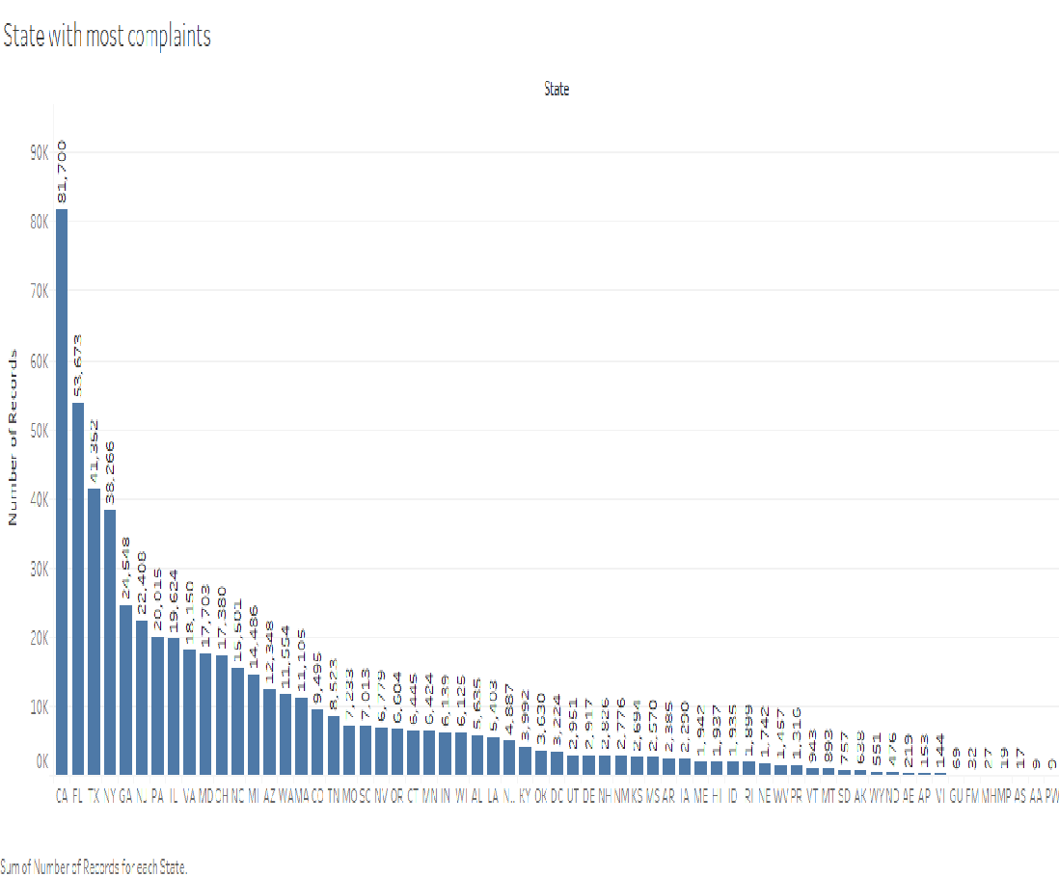
Exploratory Data Analysis
As seen from the graph, the state of CA has the highest number of complaints. This could be due to the sheer user base present in California and economic transactions that occur in the state.
Notes:
df['timely_response'].value_counts(dropna=False)
###Yes 541909
###No 14048
df['consumer_disputed?'].value_counts(dropna=False)
###No 443823
###Yes 112134

Slide 8
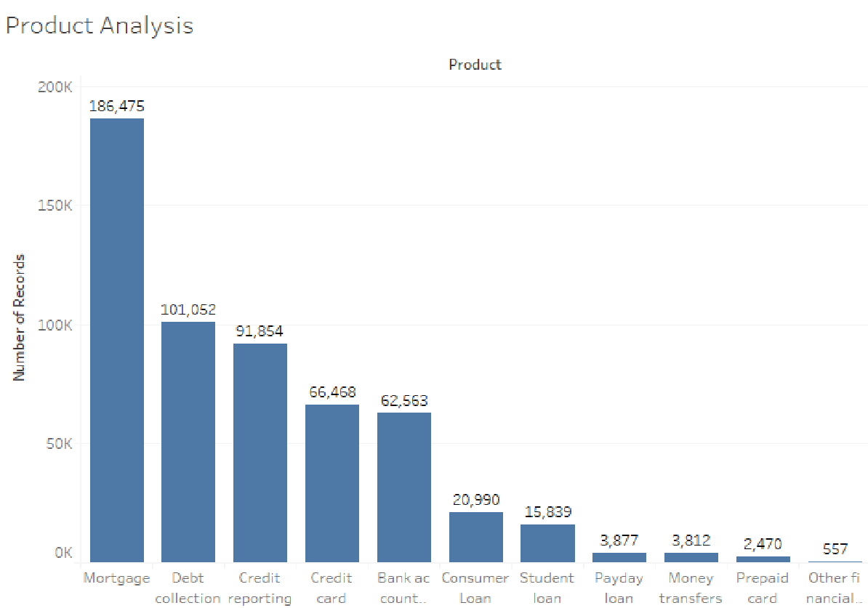
Exploratory Data Analysis
Results show that mortgage related complaints are the highest. This could be attributed to customer confusion in process for load modifications and refinancing, payment/application processing, settlement processing. ^{[1]}
Better consumer education and leaner processes could ease the complaints
Prepaid card services receive the lowest complaints. This could be due to the simple process involved in setting up, using and terminating prepaid card services.
[1] C Hudspeth, “...Mortgage Lenders Consumer Complain…”, Business Insider, Dec, 2012. Web Accessed 11/20. Link

Slide 9
Approach and Resolution

Slide 10
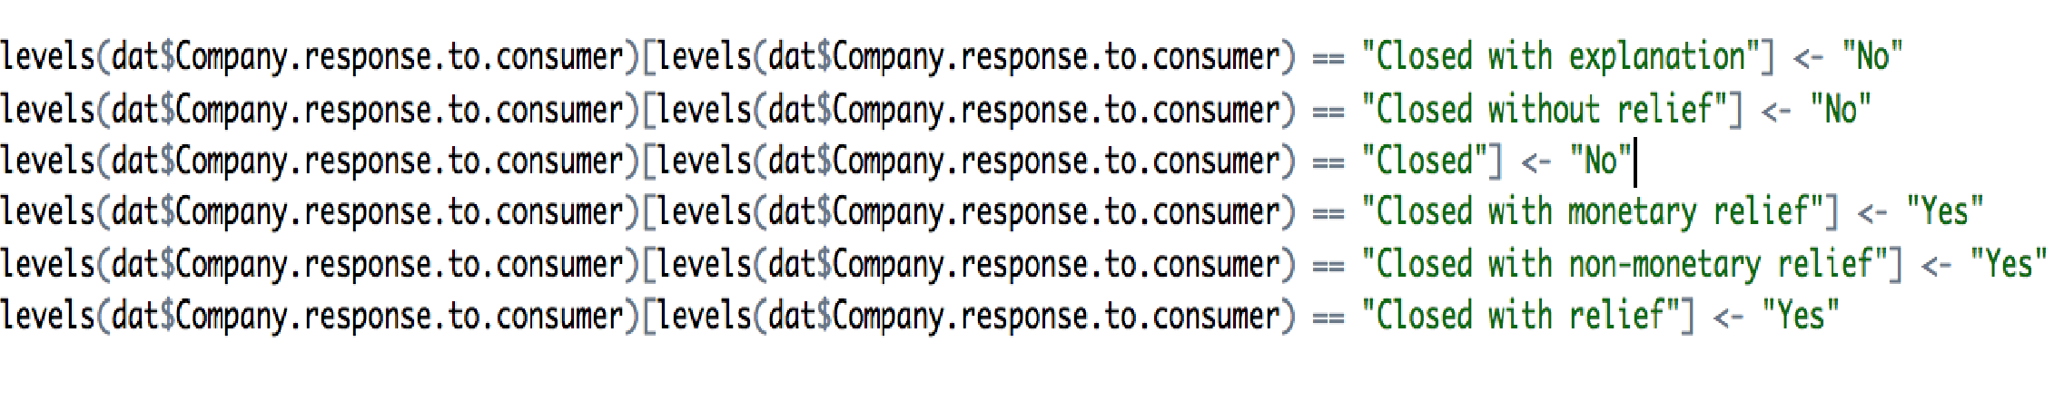
Company Response Analysis
Companies whose complaints require significant responses may be having flaws in their system
Higher response rate with some belief indicates more tricky behavior by a company. Thus, the levels were reduced based on categorization of company response.
Companies are then compared on the basis of likelihood of their response, “Yes” being the cases with substantial amount of issues in it.
Considered Companies with more than 25 Complaints to refine the analysis.
Notes:
Initial analysis not definitive, but was good starting point. Based on assumption, higher response rate leads to higher systemic fraud probability. Some factors like “In progress”, “Untimely” were not relevant hence removed.

Slide 11
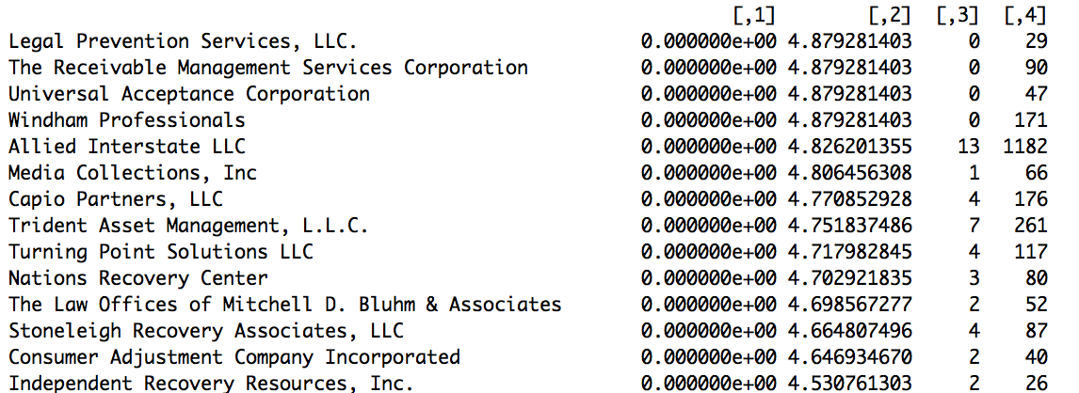
Pearson’s Chi Squared Test to determine the statistical significance of differences from likelihood i.e. prior probability of “yes” cases in dataset.
The top 15 companies based on analysis

Slide 12
Customer Experience Analysis
Aim of CFPB is to reduce the number of complaints which are being disputed by consumers. Fraction of consumers disputing is a major factor.
Similarly, we analyzed consumer disputed attribute against a particular product.
Provided insights on which products are most likely to generate complaints, the results of which are disputed by consumers.

Slide 13
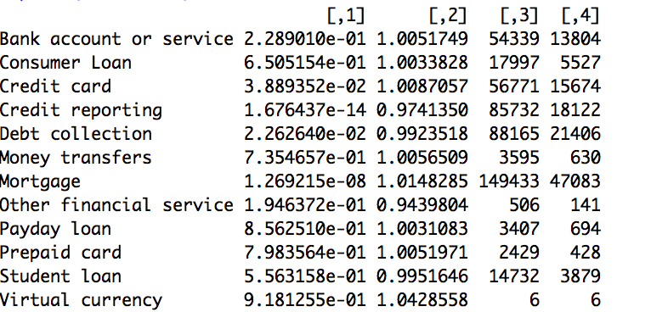
The following are results obtained after applying similar method as above(chi-square test and ratios) to the response as consumer disputed:
The ranking indicates that complaints based on bank account or service products are most likely to be disputed after receiving response from company.

Slide 14
Predictive Analysis
Predicting consumer dissatisfaction i.e. whether a consumer disputed (“yes” or “no”) for a given response from the company, based on predictors mentioned below.
Handling Missing Values
Using zip code identified missing states
Sub-product missing values with “NOT PROVIDED”
Similarly, other attributes as well
Consumer who provided consent only have complaint narrative, so for other, missing values and withdrawn, replaced with “consent not provided”.
Performed Chi Square test for determining the dependency between variables.
Test Data and Train Data : The data is divided randomly into 80% as train data and 20% test data.
Notes:
we used train test split from sklearn cross validation to do 80-20 split of data. 444765 - train instances 111192 - test instances
Handling missing values:
Company public response if blank then filling with "company choose not to provide"
Tags with unknown and submitted via with 'other'
All missing values have been handled carefully.
Combine missing value,other,and withdrawn of "Consumer consent provided? "
with Consumer consent not provided, since only users's complaints narrative will be provided
with the type of Consumer consent provided
Consent not provided 489150
Consent provided 66807
######## Handling missing values##########
df[pd.isnull(df['issue'])]
df['sub_product'].fillna('Not Provided',inplace=True)
df.info()
df['sub_issue'].fillna('Not Provided',inplace=True)
df['consumer_complaint_narrative'].fillna('None or Not Provided',inplace=True)
### Company public response if blank then filling with "company choose not to provide"
df['company_public_response'].fillna('Company chooses not to provide',inplace=True)
### Replace missing vlaues of 'Tags' with "'Unknown'
df['tags'].fillna('Unknown',inplace=True)
### Replace missing vlaues of 'Submitted via' with "'other'
df['submitted_via'].fillna('Other',inplace=True)
df['consumer_consent_provided'].fillna('Consent not provided',inplace=True)
df['consumer_consent_provided']=df['consumer_consent_provided'].apply(lambda x:
'Consent not provided' if x=='Other' or x=='Consent withdrawn' else x)
df['consumer_consent_provided'].value_counts()
df['consumer_disputed?'].value_counts()
from pyzipcode import Pyzipcode as zip
for i in df[pd.isnull(df['state'])&pd.notnull(df['zipcode'])].index:
try:
df['state'][i]=str(zip[df['zipcode'][i]].state)
except:
continue
df['state'].value_counts(dropna=False)
pd.isnull(df['state']).value_counts()
df[pd.isnull(df['state'])&pd.isnull(df['zipcode'])].shape
df['state'].fillna('Not provided',inplace=True)
df['zipcode'].fillna('Not Provided',inplace=True)
df.head()
print (df.groupby(df['consumer_disputed?'])['date_received'])
temp5 = pd.crosstab(df['consumer_consent_provided'], df['consumer_disputed?'])
temp5

Slide 15
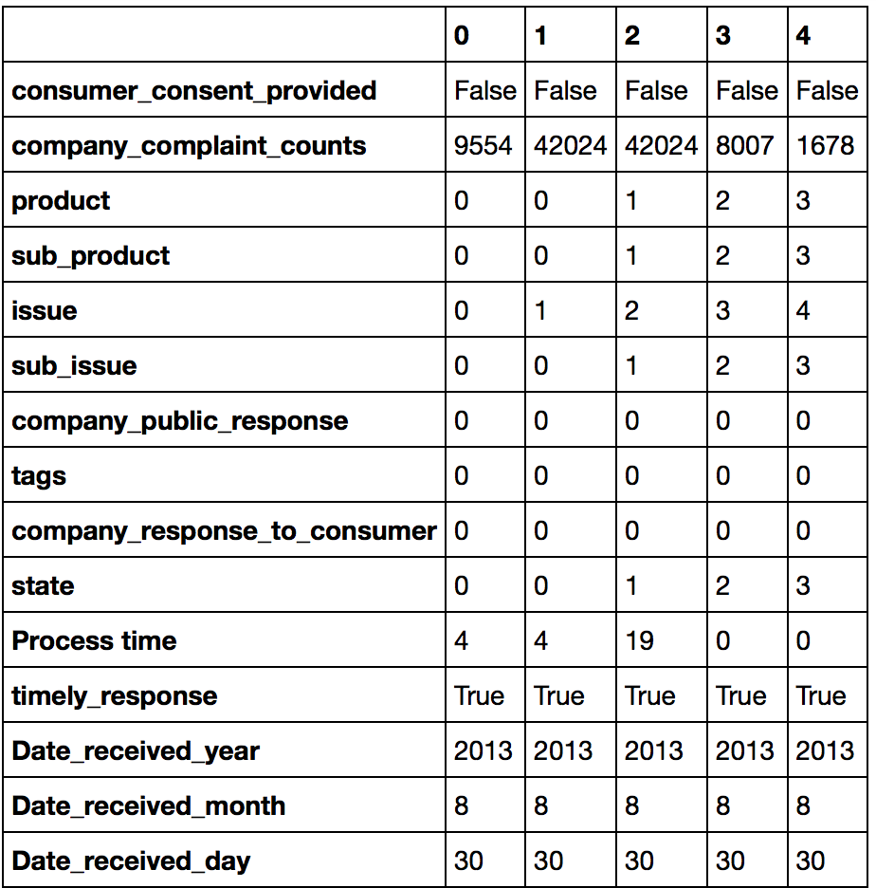
Feature Selection and Engineering
The categorical features are converted into numerical data based on levels
All variables are then converted into Boolean values based on values
Standardization using Scalar in order to maintain the mean and variation.

Slide 16
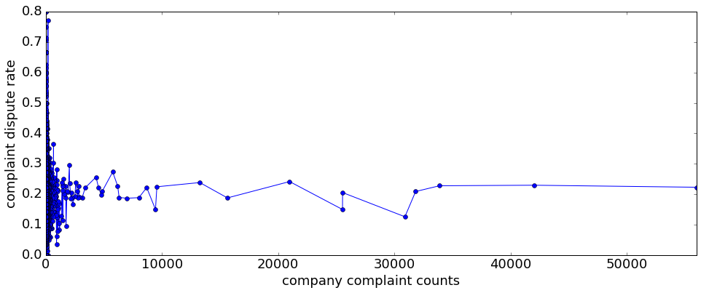

Slide 17
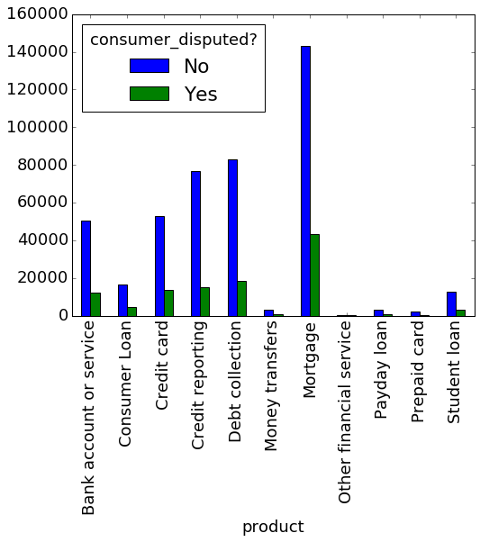

Slide 18
Tuning Aspects
New features were created from existing features which apparently proved to be helpful and important
Process Time
Company Complaint Counts
Breakdown of Received date
Main focus is to identify complaints which would be disputed by consumer
Applied text analytics heuristics like stop word removal and stemming
For example removed personal information “XXX” in this format as it was occurring in each complaint.

Slide 19
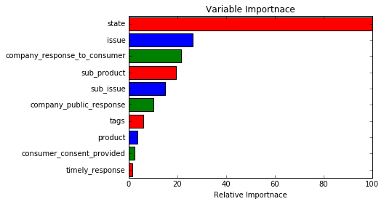
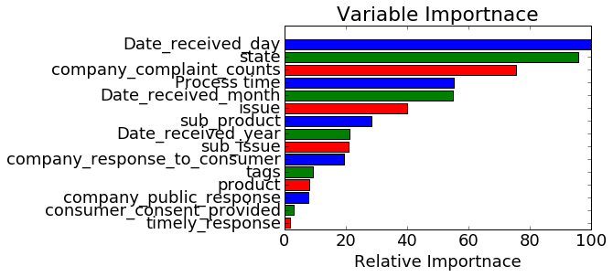
Feature Importance
Fig(1): Shows the Variable importance for base case Random Forest
Fig(2): Shows the Variable importance of Random Forest after feature engineering .

Slide 20
Model Application(Non-Text Features)

Slide 21
Results
The logistic regression is giving best results in terms of classifying most number of complaints for which consumer are likely to dispute.
 | Test Accuracy(No tuning) | Test Accuracy(With New features) | Recall score (test)
Logistic Regression | 51.53% | 53.54% | 50 to 57.7%
Decision Tree | 72.06% | 77.1% | 9% (Almost similar for both)
Random Forest | 60.16% | 79.16% | 33.29% to 45%
KNN (k=10) | 77% | 79.45% | 3% to 6%

Slide 23
The other models does not give appropriate recall score in terms of classifying consumer disputed complaints.
Even though the accuracy is better for other models, the focus here is to identify complaints for which consumers would most likely dispute.
Added new features/predictors by calculating the number of complaints related to each company and process time.
Process time refers to days between the date CFPB received complaints and the date when complaints were sent to company on behalf of consumer.

Slide 24
Model Application(Text features)
A new prediction model was developed using the features extracted from “consumer complaint narrative”.
The complaint text was subjected to tf-idf vectorization after NLTK stopword removal and Snowball Stemming.
Multinomial Naive Bayes and Stochastic Gradient Descent Classifier (SGDC) with loss function “log” using vectorized matrix.
Model accuracy obtained :
Multinomial Naive Bayes: 61.9%
SGDC: 63.5%
Notes:
A Comparison of Event Models for Naive Bayes Text Classification
(http://www.cs.cmu.edu/~knigam/papers/multinomial-aaaiws98.pdf)

Slide 25
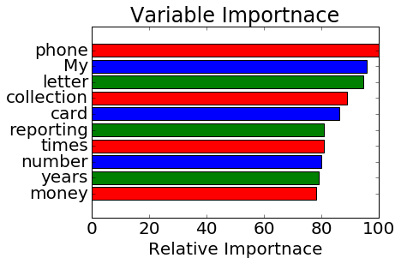
Feature Importance(Text Features)
Top 10 features of the text attribute is presented above .
This is obtained using random forest

Slide 26
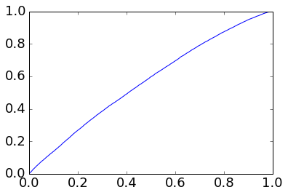
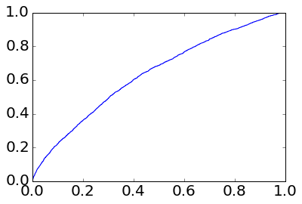
Comparison of Models
Non-text data model vs text data model
roc=0.57 roc=0.64
From the comparison we see that the Text data provided better prediction results for whether or not the consumer disputed a particular complaint.

Slide 27
Stochastic Gradient Descent Classification
This algorithm is used for effective approach for discriminative learning of linear classifiers under convex loss function.
Used by linear classifiers such as Support vector Machine and Logistic Regression
Used widely for effective classification of text data and natural language processing.
SGDC supports following loss function:
hinge:linear support machine
modified_huber:smoothed hinge loss
log: logistic regression

Slide 28
Conclusions
Consumer experience and company response analysis provide insights on top companies and products respectively.
We analyzed and predicted the probability of complaints that would turn into disputes.
According to the results, the logistic regression model is providing better results compared to other learning algorithms for the non text features.
We analyzed Text features against class value(Consumer disputed) using SGDC and Multinomial Naive Bayes.
The identification of complaints correctly would result in better user experience and would be used to further improve financial complaint system.
According to our analysis consumer who provide precise narrative about the product complaint will result into better understanding of predicting whether the complaint would be disputed or not.

Slide 29
Future Work
The interaction effects or synergy effects are not considered in our analysis and could be a prospect in future analysis.
The text features could be combined with other categorical attributes to improve modeling.
Implement similar models to other types of complaint management.

Slide 30
THANK YOU

